Slide 1
Wireless Security

Slide 2
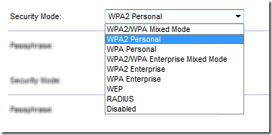
Wireless Security types
Configure authentication on access point or router
Open
No password needed for access
WPA Personal / WPA-PSK
WPA2 with Pre-Shared Key
Same 256-bit key for all users
WPA-Enterprise / 802.1X
Users authenticated via server (e.g. RADIUS and the like)

Slide 3
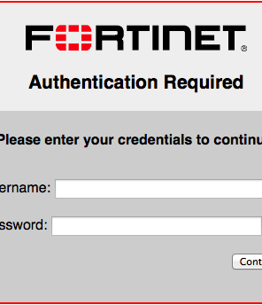
Captive Portal
Provides login page for users
Device not registered on network
Sent to captive portal landing page
Show Acceptable Use Policy, Terms of Service, Pricing
Sign in with username/password, point of contact name, hotel room name/number, customer payment/advertisement
Once authenticated, network access granted

Slide 4

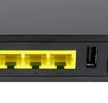
Using WPS
Wi-Fi Protected Setup
Provides easy setup for joining a device to a network
Different ways to connect:
Push a button on the access point
Enter a PIN on access point into device
Near-field communication (NFC) – bring the mobile device close to access point

Slide 5


Hacking WPS
PIN is an eight-digit number
7+1, seven digits followed by a checksum digit
Seven digits = 10,000,000 possible combinations
8th digit is computed based on first 7 digits
WPS validates the PIN in halves
First half: 4 digits (10,000 possibilities: 0000-9999)
Second half: 3 digits (1,000 possibilities: 000-999)
Total number of guesses is 11,000 (much less than the original 10,000,000 combinations!)
Automated process will cycle through all 11,000 possible combinations in under 4 hours.

Slide 6

Protecting WPS PIN
Attacker only needs 11,000 possible guesses
(4 hours may seem like a long time, but a determined hacker can setup a device and walk away, come back later after it’s cracked it.)
Slow down the amount of time between entries
Not often a legitimate user will enter wrong PIN multiple times
More wrong guesses = increased delay between PIN entries
Make hack take from 4 hours to hundreds or thousands of hours
Intrusion Protection System should alert to too many bad PIN attempts

Slide 7
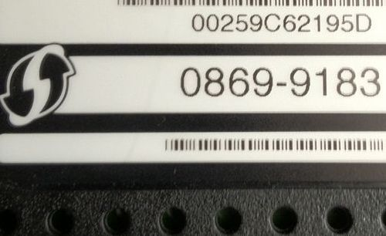

Protecting WPS
Pushbutton allows any device to join the network
Physically protect router or access point
Do not allow unauthorized users to press the button
Better: Disable the WPS pushbutton!
WPS PIN may be visible on the access point
DO NOT keep the default PIN
Hide the PIN, keep it out of sight
WPS PIN

